Slide 1
Blackbox Optimization
Exploring Techniques and Applications

Slide 2
What is Blackbox Optimization?
Blackbox optimization refers to the process of optimizing a function without explicit knowledge of its internal workings
Such functions are called 'blackboxes' because their inputs and outputs are observable, but the process transforming these inputs into outputs remains hidden
This approach is common in scenarios where the function is complex, expensive to evaluate, or proprietary

Slide 3
Applications of Blackbox Optimization
Used across various fields such as engineering, machine learning, finance, and more, where direct optimization techniques cannot be applied due to the lack of an analytical form of the function
In machine learning, it optimizes hyperparameters of models to achieve better performance
Engineering applications include optimizing design parameters for improved efficiency and performance

Slide 4
Key Techniques in Blackbox Optimization
Evolutionary algorithms mimic natural evolutionary processes to iteratively find optimal solutions
Bayesian optimization uses statistical models to guide the search for the optimum and is particularly effective when evaluations of the function are costly
Gradient-free methods such as simulated annealing, which rely on probabilistic transitions to search for minima or maxima

Slide 5

Evolutionary Algorithms
An Overview
By simulating processes such as natural selection and genetic mutation, these algorithms evolve solutions over generations
Widely used for multi-objective optimization problems
Key advantage: ability to escape local optima, exploring a wider solution space

Slide 6
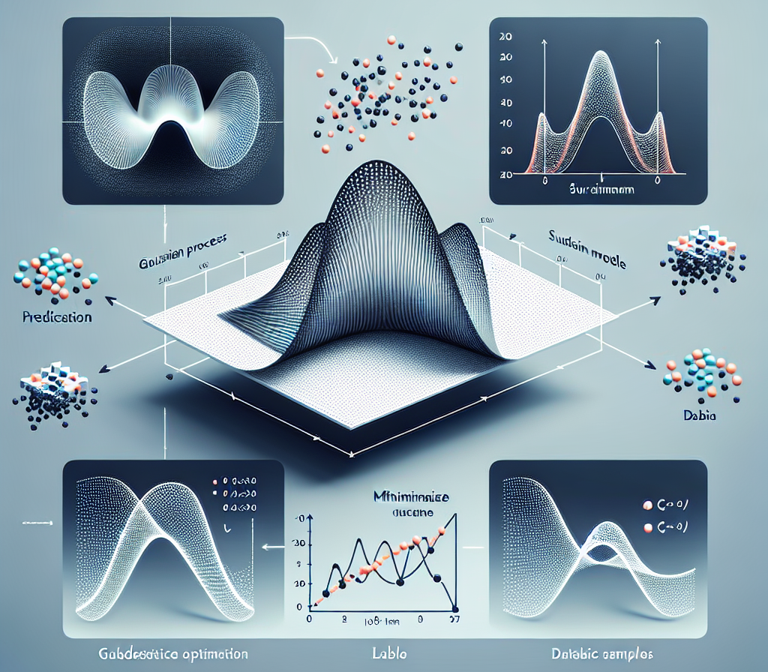
Bayesian Optimization
Efficient Use of Function Evaluations
Builds a probabilistic model of the objective function and updates this model as more evaluations are performed
Selects the next point to evaluate by balancing exploration of uncharted areas and exploitation of known promising areas
Ideal for optimizing expensive functions with very few evaluations

Slide 7
Challenges in Blackbox Optimization
Handling noisy or incomplete function evaluations, which can lead to suboptimal solutions
Scalability issues as the dimensionality of the problem increases, often referred to as the 'curse of dimensionality'
Balancing exploration and exploitation to efficiently navigate the solution space

Slide 8
Future Directions
Integration of machine learning techniques to create more efficient optimization algorithms
Developing approaches that can effectively deal with high-dimensional problems
Advancements in handling uncertainties and dynamic environments during the optimization process

Slide 9
References
1. Holland, J.H. (1992). Adaptation in Natural and Artificial Systems. University of Michigan Press.
2. Mockus, J. (1989). Bayesian Approach to Global Optimization. Kluwer Academic Publishers.
3. Kirkpatrick, S., Gelatt, C.D., & Vecchi, M.P. (1983). Optimization by Simulated Annealing. Science, 220(4598), 671-680.
4. Goldberg, D.E. (1989). Genetic Algorithms in Search, Optimization and Machine Learning. Addison-Wesley.
5. Snoek, J., Larochelle, H., & Adams, R.P. (2012). Practical Bayesian Optimization of Machine Learning Algorithms. Advances in Neural Information Processing Systems.

Slide 10

Conclusion
Blackbox optimization offers a powerful set of tools for tackling complex optimization problems where traditional methods fall short
Continuous research and technological advancements promise to expand its capabilities and applications
The key to success lies in choosing the right technique and balancing exploration with exploitation to efficiently find optimal solutions

Slide 11
Thank You
Thank you for your attention
Any questions?

